Slide 1
Middle School Career Exploration Course
Jesse Damian
Career and College Readiness Counselor

Slide 2
SB 70 Middle Grades CTE and Career Pathways Grant 2011-2012 (One-time Funding)
The six participating middle schools offered a minimum of one section 8th grade Career Exploration course that began the second semester of the 2011-12 school year. Some schools also included their 6th and 7th graders.
Round Valley Elementary
Potter Valley Middle School
Fort Bragg Middle School
Pomolita Middle School
Eagle Peak Middle School
MCOE Alternative Education
8th Graders Served 142
Other Grades 61
Total Students Served 203

Slide 3
Requirements
All students had to take a pre and post-survey
All students were required to take a career interest inventory (based on Dr. John Holland’s career model)
Expose students to various CTE pathway options at their high school and understand the meaning of “a-g” course requirements
Develop and complete a flexible, but detailed Student Education and Career Plan.
Capture student information to check in with them in upcoming years
Teacher input at the end of the semester

Slide 4
Sustainability
Our goal is now to work with schools to continue this effort. With the success of year one, the interest has grown from six sites to eleven county-wide (for the 2012-13 school year we now have seven schools offering the course).
The schools that only offered one course in their schedules are strategizing to integrate the content into other subjects to target all of their 8th graders.
We also created a repository of information (web site) targeting educators that work in the middle grades and beyond. The purpose of this site is to support district personnel in building the district’s capacity to provide and sustain career development courses and guidance.

Slide 5
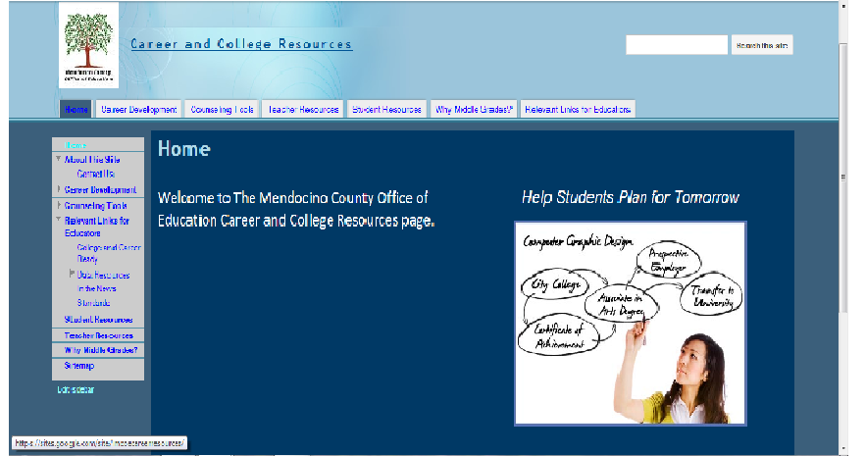
https://sites.google.com/site/mcoecareerresources/home

